Slide 1
Object Pose Estimation using Monocular Camera
Karthik Paigwar - BT15CSE038
Sreechandra Allala - BT15CSE009

Slide 2
Perspective-n-Point
Perspective-n-Point is the problem of estimating the pose of a calibrated camera given a set of n 3D points in the world and their corresponding 2D projections in the image.
Notes:
The pose of an object refers to its relative orientation and position with repsiect to a cmaera. You can change the pose by either moving the object with repsect to the camera, or the camra with respect to the object.
Pose Estimation problem is often referred to as PnP

Slide 3
Perspective-n-Point
Perspective-n-Point is the problem of estimating the pose of a calibrated camera given a set of n 3D points in the world and their corresponding 2D projections in the image.
The camera pose consists of 6 degrees-of-freedom (DOF) which are made up of the rotation (roll, pitch, and yaw) and 3D translation of the camera with respect to the world
Notes:
The pose of an object refers to its relative orientation and position with repsiect to a cmaera. You can change the pose by either moving the object with repsect to the camera, or the camra with respect to the object.
Pose Estimation problem is often referred to as PnP

Slide 4
Problem Specification
Given a set of n 3D points in a world reference frame and their corresponding 2D image projections as well as the calibrated intrinsic camera parameters, determine the 6 DOF pose of the camera in the form of its rotation and translation with respect to the world.
.
.
Notes:
The pose of an object refers to its relative orientation and position with repsiect to a cmaera. You can change the pose by either moving the object with repsect to the camera, or the camra with respect to the object.
Pose Estimation problem is often referred to as PnP

Slide 5
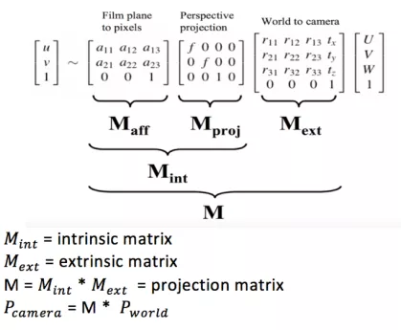
This follows the perspective project model for cameras:

Slide 6
Calculating 3D pose of an object
2D coordinates of a few points
3D locations of the same points
Intrinsic parameters of the camera.

Slide 7
Calculating Intrinsic Camera Parameters
ROS Camera Callibration package has been used to callibrate the camera and calculate intrinsic parameters
A monocular camera publishes images over ROS
A large checkerboard with dimensions 7x6 with 50mm squares.
A well lit 5m x 5m area clear of obstructions and check board patterns.

Slide 8
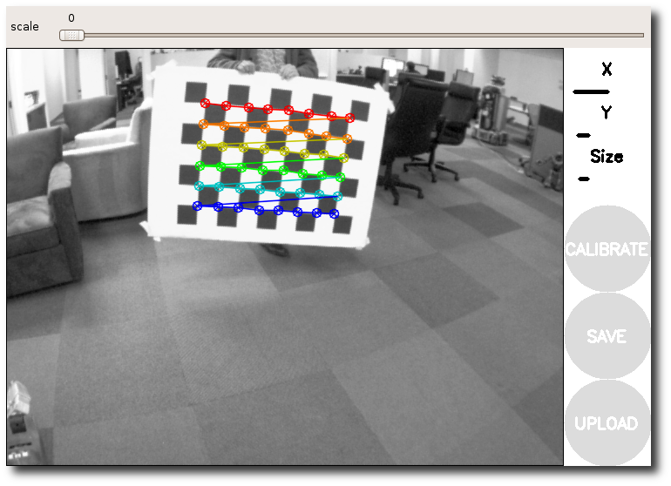
ROS Camera Callibration

Slide 9
Parameters obtained from Camera Callibration
Camera matrix:
[[707.975174, 0.000000, 326.343126]
[0.000000, 711.961538, 232.354595]
[0.000000, 0.000000, 1.000000]]
Distortion matrix
[0.085624, -0.579964, -0.007464, 0.008612, 0.000000]

Slide 10
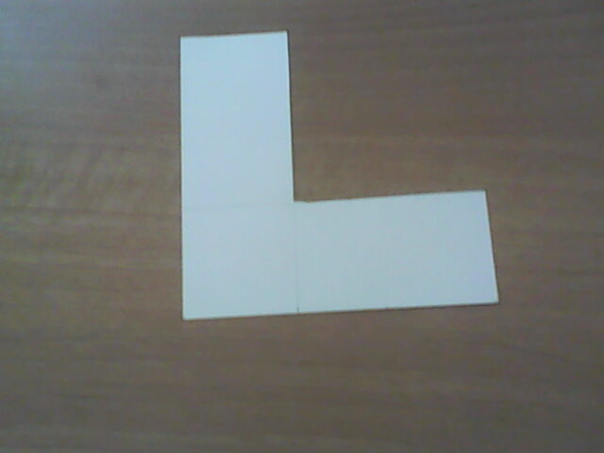
Custom Marker used for pose estimation
White Colour L-Shaped Marker
Length : 12cm x 12cm
Width : 4.5cm

Slide 11
Calculating 3D World Points
(0.0, 0.0, 0.0),
(-45.0, -45.0, 0.0),
(75.0, -45.0, 0.0),
(-45.0, 75.0, 0.0),
(75.0, 0.0, 0.0),
(0.0, 75.0, 0.0)

Slide 12
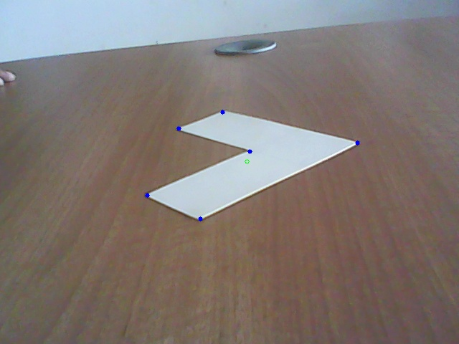
Calculating corresponding image coordinates
Thresholding & Closing.
Finding Contours.
Fitting a Polygon till 6 corner points are obtained ( using approxPolyDP method of openCV).

Slide 13
Finding inner center corner
Finding centroid of the object using Moments and then calculating the point which has the least Euclidean distance from this centroid.

Slide 14
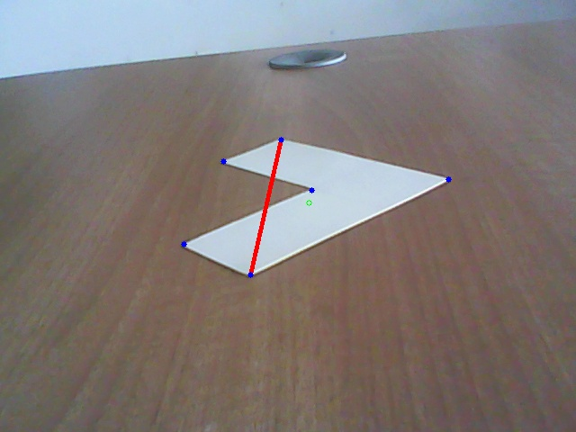
Finding Other Corners
Estimate a line (joining two corners of the object) such that 2 corners lie to its left and 2 to its right.
Top most corner and the inner corner lie on the same side of the line.
Then Ordering the rest of the corners using these two corners.

Slide 15
SolvePnPRansac
When n = 3, the PnP problem is in its minimal form of P3P and can be solved with three point correspondences. However, with just three point correspondences, P3P yields many solutions, so a fourth correspondence is used in practice to remove ambiguity.
PnP is prone to errors if there are outliers in the set of point correspondences. Thus, RANSAC can be used in conjunction with existing solutions to make the final solution for the camera pose more robust to outliers

Slide 16
Thank You

